Slide 1
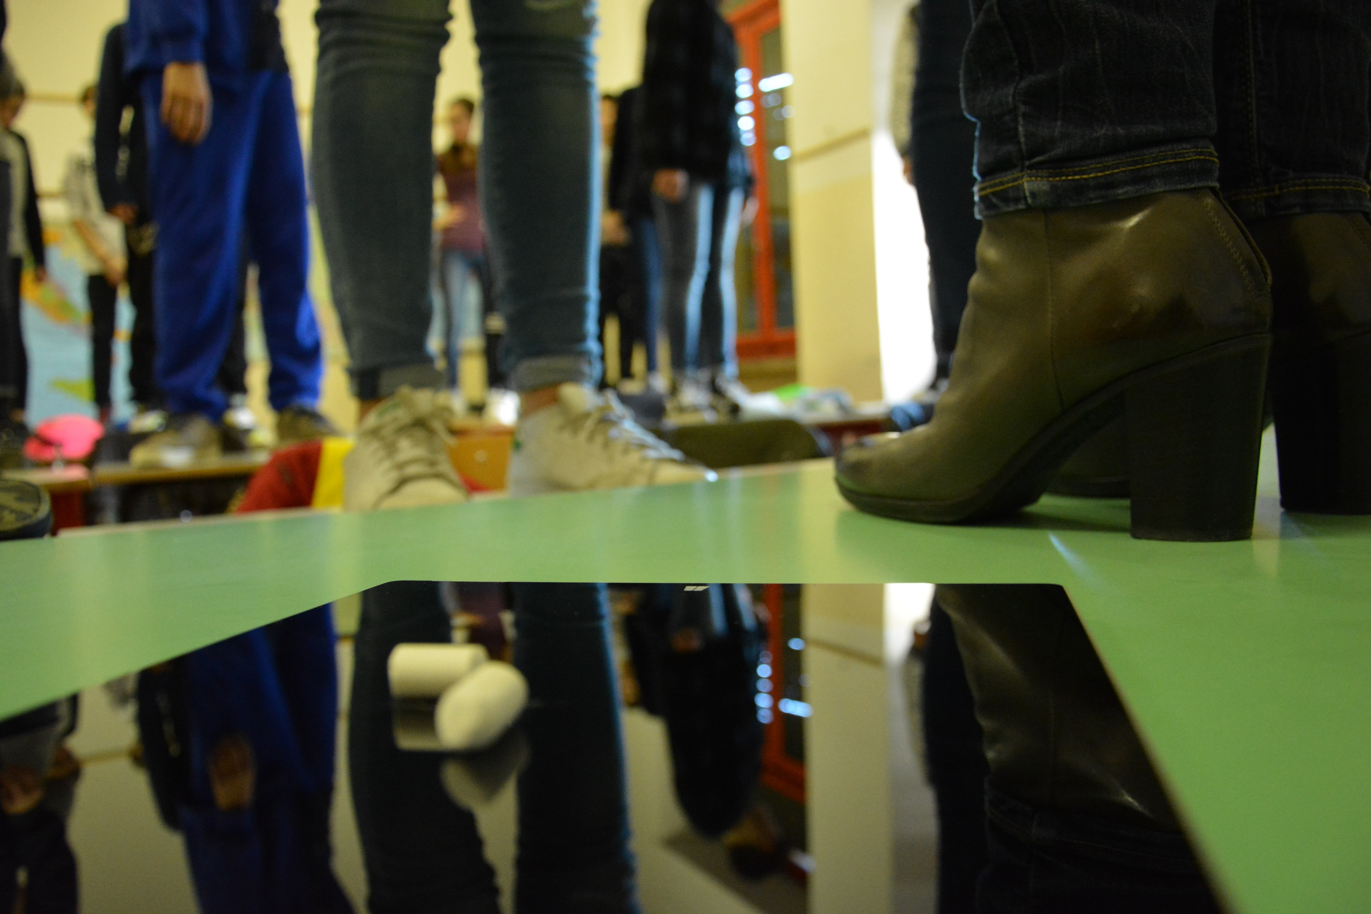
Coding in your Classroom, Now!

Slide 2
Coding in your Classroom, Now!

